Slide 1
Unit 4: Transport Layer
Our goals:
understand principles behind transport layer services:
multiplexing/demultiplexing
reliable data transfer
flow control
congestion control
learn about transport layer protocols in the Internet:
UDP: connectionless transport
TCP: connection-oriented transport
TCP congestion control

Slide 2
Unit 4 outline
4.1 Transport-layer services
4.2 Multiplexing and demultiplexing
4.3 Connectionless transport: UDP
4.4 Principles of reliable data transfer
4.5 Connection-oriented transport: TCP
segment structure
reliable data transfer
flow control
connection management
4.6 Principles of congestion control
4.7 TCP congestion control

Slide 3

Transport services and protocols
provide logical communication between app processes running on different hosts
transport protocols run in end systems
send side: breaks app messages into segments, passes to network layer
rcv side: reassembles segments into messages, passes to app layer
more than one transport protocol available to apps
Internet: TCP and UDP
application
transport
network
data link
physical
logical end-end transport
application
transport
network
data link
physical
TCP: Transmission Control Protocol
UDP: User Datagram Protocol

Slide 4
Transport vs. network layer
Household analogy:
12 kids (west coast) sending letters to their cousins , another 12 kids (east coast)
processes = kids
app messages = letters in envelopes
hosts = houses
transport protocol = Ann in the west coast house and Bill in the east coast house (responsible for mail collection and distribution)
network-layer protocol = postal service
network layer: logical communication between hosts
transport layer: logical communication between processes
relies on, enhances, network layer services
How is transport layer related to network layer

Slide 5










Household analogy
kids = Processes
kids = Processes
Ann
transport protocol
Bill
houses = hosts
transport protocol
postal service = network-layer protocol
houses = hosts
app messages = letters in envelopes

Slide 6
Sockets
process sends/receives messages to/from its socket
socket analogous to door
sending process shoves message out door
sending process relies on transport infrastructure on other side of door which brings message to socket at receiving process
host or
server
host or
server
controlled by
app developer
process
process
socket
socket
TCP with
buffers,
variables
TCP with
buffers,
variables
Internet
controlled
by OS

Slide 7
Addressing processes
to receive messages, process must have identifier
host device has unique 32-bit IP address
Q: does IP address of host suffice for identifying the process?

Slide 8
Addressing processes
to receive messages, process must have identifier
host device has unique 32-bit IP address
Q: does IP address of host suffice for identifying the process?
A: No, many processes can be running on same host
identifier includes both IP address and port numbers associated with process on host.
Example port numbers:
HTTP server: 80
Mail server: 25
to send HTTP message to 128.119.245.12 web server:
Socket:
128.119.245.12:80

Slide 9
Internet transport-layer protocols
reliable, in-order delivery (TCP)
congestion control
flow control
connection setup
integrity checking
unreliable, unordered delivery: UDP
no-frills extension of “best-effort” IP
two services: process-to-process data delivery and error checking
services not available:
No delay guarantees
No bandwidth guarantees
application
transport
network
data link
physical
network
data link
physical
network
data link
physical
logical end-end transport
network
data link
physical
network
data link
physical
network
data link
physical
network
data link
physical
application
transport
network
data link
physical

Slide 10
Unit 4 outline
4.1 Transport-layer services
4.2 Multiplexing and demultiplexing
4.3 Connectionless transport: UDP
4.4 Principles of reliable data transfer
4.5 Connection-oriented transport: TCP
segment structure
reliable data transfer
flow control
connection management
4.6 Principles of congestion control
4.7 TCP congestion control

Slide 11
Multiplexing/demultiplexing (1)
Demultiplexing at rcv host:
Multiplexing at send host:
delivering received segments
to correct socket
gathering data from multiple
sockets, enveloping data with
header (later used for
demultiplexing)
= socket
= process
application
application
application
P4
P3
P1
P2
P1
transport
transport
transport
network
network
network
link
link
link
physical
physical
physical
host 1
host 2
host 3

Slide 12
Multiplexing/demultiplexing (2)
AP₁
process
process
AP₄
5
4
3
2
1
AP₂
socket
AP₃
5
4
3
2
1
socket
logic communication between app processes
IP layer
Host A
Host B
R₁
R₂
AP₁
AP₃
LAN₁
WAN
LAN₂
AP₂
AP₄
IP working area
TCP and UDP working area

Slide 13
How demultiplexing works
host receives IP datagrams
each datagram has source IP address, destination IP address
each datagram carries 1 transport-layer segment
each segment has source, destination port numbers
host uses IP addresses & port numbers to direct segment to appropriate socket
The port numbers ranging from 0 to 1023 are called well-known port numbers
HTTP → 80
FTP → 21
16-bit port number: 0-65535
32 bits
source port #
dest port #
other header fields
application
data
(message)
TCP/UDP segment format

Slide 14
Connectionless demultiplexing
When host receives UDP segment:
checks destination port number in segment
directs UDP segment to socket with that port number
IP datagrams with different source IP addresses and/or source port numbers directed to same socket
Create sockets with port numbers (Java):
DatagramSocket mySocket1 = new DatagramSocket();
or
DatagramSocket mySocket2 = new DatagramSocket(12535);
UDP socket identified by two-tuple:
(dest IP address, dest port number)
client side
automatically assign the port number
server side
Q:What is the purpose of the source port number in UDP?
Notes:
tuple
英 [ tʌpl ] 美 [ tʌpl ]
n.[计算机]元组，数组

Slide 15
Connectionless demux (cont)
DatagramSocket serverSocket = new DatagramSocket(6428);
P2
P1
P3
P1
SP: 6428
SP: 6428
DP: 9157
DP: 5775
SP: 9157
SP: 5775
client
IP: A
DP: 6428
server
IP: C
DP: 6428
Client
IP:B
SP provides “return address”

Slide 16
Connection-oriented demux
TCP socket identified by 4-tuple:
source IP address
source port number
dest IP address
dest port number
Two arriving TCP segments with different source IP addresses or source port numbers will be directed to two different sockets.
Server host may support many simultaneous TCP sockets:
each socket identified by its own 4-tuple
Web servers have different sockets for each connecting client
non-persistent HTTP will have different socket for each request

Slide 17
Connection-oriented demux (cont)
P1
P4
P5
P6
P2
P1
P3
SP: 5775
DP: 80
S-IP: B
D-IP:C
SP: 9157
SP: 9157
client
IP: A
DP: 80
server
IP: C
DP: 80
Client
IP:B
S-IP: A
S-IP: B
D-IP:C
D-IP:C

Slide 18
Connection-oriented demux: Threaded Web Server
P1
P4
P2
P1
P3
SP: 5775
DP: 80
S-IP: B
D-IP:C
SP: 9157
SP: 9157
client
IP: A
DP: 80
server
IP: C
DP: 80
Client
IP:B
S-IP: A
S-IP: B
D-IP:C
D-IP:C

Slide 19
Unit 4 outline
4.1 Transport-layer services
4.2 Multiplexing and demultiplexing
4.3 Connectionless transport: UDP
4.4 Principles of reliable data transfer
4.5 Connection-oriented transport: TCP
segment structure
reliable data transfer
flow control
connection management
4.6 Principles of congestion control
4.7 TCP congestion control

Slide 20
UDP: User Datagram Protocol [RFC 768]
“no frills,” “bare bones” Internet transport protocol
“best effort” service, UDP segments may be:
lost
delivered out of order to app
connectionless:
no handshaking between UDP sender, receiver
each UDP segment handled independently of others => no relations among UDP packets => no info about the order
Why is there a UDP?
no connection establishment (which can add delay)
simple: no connection state at sender, receiver
small segment header (8 bytes)
no congestion control: UDP can blast away as fast as desired
Notes:
No frills
释义不提供不必要服务的 不加装璜

Slide 21
UDP: more
8-byte fixed length header
often used for streaming multimedia apps
loss tolerant
rate sensitive
other UDP uses
DNS
SNMP
reliable transfer over UDP: add reliability at application layer
application-specific error recovery!
32 bits
Length, in
bytes of UDP
segment,
including
header
source port #
dest port #
length
checksum
Application
data
(message)
UDP segment format
Notes:
Stream 鱼贯而行 一个接一个地移动
vt.按能力分班（或分组） 按能力分班（或分组）
SNMP - Simple Network Management Protocol

Slide 22
UDP checksum
Goal: detect “errors” (e.g., flipped bits) in transmitted segment
Sender:
treat segment contents as sequence of 16-bit integers
checksum: addition (1’s complement sum) of segment contents
sender puts checksum value into UDP checksum field
Receiver:
compute checksum of received segment
check if computed checksum equals checksum field value:
NO - error detected
YES - no error detected. But maybe errors nonetheless? More later ….
some errors are not detected by this checksum method
Notes:
flipped from 0 to 1 and vice versa

Slide 23
Unit 4 outline
4.1 Transport-layer services
4.2 Multiplexing and demultiplexing
4.3 Connectionless transport: UDP
4.4 Principles of reliable data transfer
4.5 Connection-oriented transport: TCP
segment structure
reliable data transfer
flow control
connection management
4.6 Principles of congestion control
4.7 TCP congestion control

Slide 24
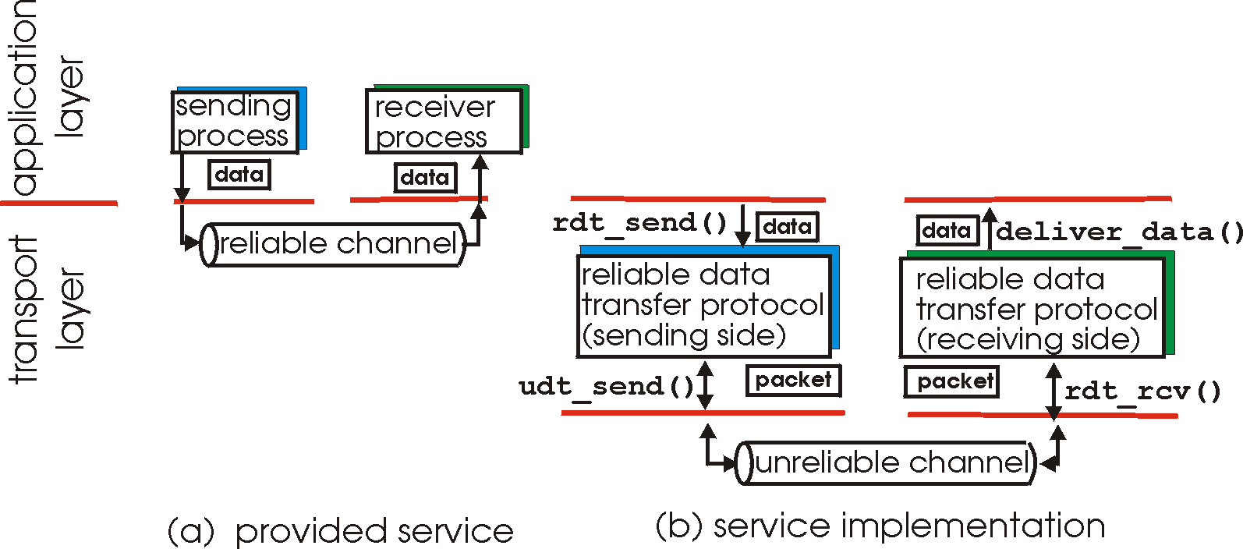
Principles of Reliable data transfer
important in app., transport, link layers
top-10 list of important networking topics!
characteristics of unreliable channel will determine complexity of reliable data transfer protocol (rdt)

Slide 25
Principles of Reliable data transfer
important in app., transport, link layers
top-10 list of important networking topics!
characteristics of unreliable channel will determine complexity of reliable data transfer protocol (rdt)

Slide 26
Principles of Reliable data transfer
important in app., transport, link layers
top-10 list of important networking topics!
characteristics of unreliable channel will determine complexity of reliable data transfer protocol (rdt)

Slide 27
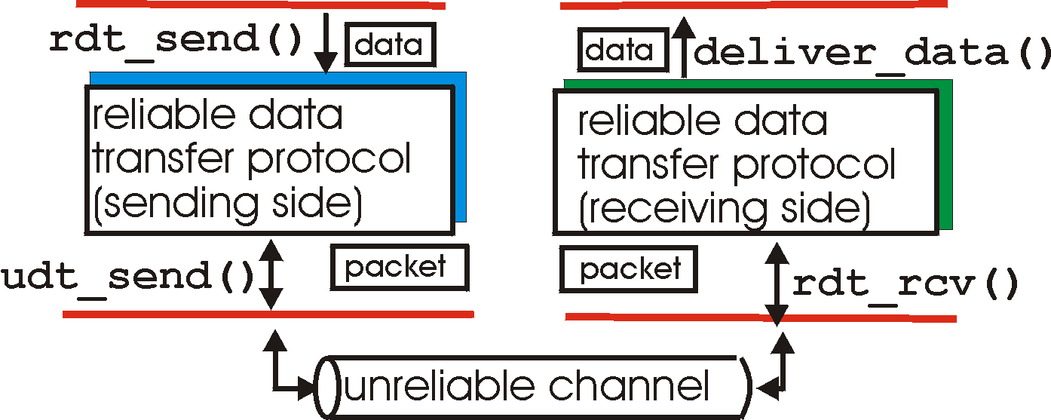
Reliable data transfer: getting started
rdt_send(): called from above, (e.g., by app.). Passed data to
deliver to receiver upper layer
deliver_data(): called by rdt to deliver data to upper
send
side
receive
side
udt_send(): called by rdt,
to transfer packet over
unreliable channel to receiver
rdt_rcv(): called when packet arrives on rcv-side of channel

Slide 28
Reliable data transfer: getting started
We’ll:
incrementally develop sender, receiver sides of reliable data transfer protocol (rdt)
consider only unidirectional data transfer
but control info will flow on both directions!
use finite state machines (FSM) to specify sender, receiver
event causing state transition
actions taken on state transition
state: when in this “state” next state uniquely determined by next event
state
1
state
2
event
actions

Slide 29
Rdt1.0: reliable transfer over a reliable channel
underlying channel perfectly reliable
no bit errors
no loss of packets
separate FSMs for sender, receiver:
sender sends data into underlying channel
receiver read data from underlying channel
Wait for call from above
rdt_send(data)
Wait for call from below
rdt_rcv(packet)
extract (packet,data)
deliver_data(data)
packet = make_pkt(data)
udt_send(packet)
sender
receiver

Slide 30
Rdt2.0: channel with bit errors
underlying channel may flip bits in packet
checksum to detect bit errors
the question: how to recover from errors:
acknowledgements (ACKs): receiver explicitly tells sender that pkt received OK
negative acknowledgements (NAKs): receiver explicitly tells sender that pkt had errors
sender retransmits pkt on receipt of NAK
new mechanisms in rdt2.0 (beyond rdt1.0):
error detection
receiver feedback: control msgs (ACK,NAK) rcvr->sender

Slide 31
rdt2.0: FSM specification
rdt_send(data)
sndpkt = make_pkt(data, checksum)
udt_send(sndpkt)
receiver
rdt_rcv(rcvpkt) &&
isNAK(rcvpkt)
Wait for call from above
Wait for ACK or NAK
rdt_rcv(rcvpkt) &&
corrupt(rcvpkt)
udt_send(sndpkt)
udt_send(NAK)
rdt_rcv(rcvpkt) && isACK(rcvpkt)
Λ
Wait for call from below
sender
rdt_rcv(rcvpkt) &&
notcorrupt(rcvpkt)
extract(rcvpkt,data)
deliver_data(data)
udt_send(ACK)

Slide 32
rdt2.0: operation with no errors
rdt_send(data)
sndpkt = make_pkt(data, checksum)
udt_send(sndpkt)
rdt_rcv(rcvpkt) &&
isNAK(rcvpkt)
Wait for call from above
Wait for ACK or NAK
rdt_rcv(rcvpkt) &&
corrupt(rcvpkt)
udt_send(sndpkt)
udt_send(NAK)
rdt_rcv(rcvpkt) && isACK(rcvpkt)
Λ
Wait for call from below
rdt_rcv(rcvpkt) &&
notcorrupt(rcvpkt)
extract(rcvpkt,data)
deliver_data(data)
udt_send(ACK)

Slide 33
rdt2.0: error scenario
rdt_send(data)
snkpkt = make_pkt(data, checksum)
udt_send(sndpkt)
rdt_rcv(rcvpkt) &&
isNAK(rcvpkt)
Wait for call from above
Wait for ACK or NAK
rdt_rcv(rcvpkt) &&
corrupt(rcvpkt)
udt_send(sndpkt)
udt_send(NAK)
rdt_rcv(rcvpkt) && isACK(rcvpkt)
Wait for call from below
Λ
rdt_rcv(rcvpkt) &&
notcorrupt(rcvpkt)
extract(rcvpkt,data)
deliver_data(data)
udt_send(ACK)

Slide 34
rdt2.0 has a fatal flaw!
What happens if ACK/NAK corrupted?
sender doesn’t know what happened at receiver!
can’t just retransmit: possible duplicate
Handling duplicates:
sender retransmits current pkt if ACK/NAK garbled
sender adds sequence number to each pkt
receiver discards (doesn’t deliver up) duplicate pkt
One bit for sequence numbers is sufficient for this case
stop and wait protocol
Sender sends one packet,
then waits for receiver
response

Slide 35
rdt2.1: sender, handles garbled ACK/NAKs
rdt_send(data)
sndpkt = make_pkt(0, data, checksum)
udt_send(sndpkt)
rdt_rcv(rcvpkt) &&
( corrupt(rcvpkt) ||
isNAK(rcvpkt) )
Wait for call 0 from above
Wait for ACK or NAK 0
udt_send(sndpkt)
rdt_rcv(rcvpkt)
&& notcorrupt(rcvpkt)
&& isACK(rcvpkt)
rdt_rcv(rcvpkt)
&& notcorrupt(rcvpkt)
&& isACK(rcvpkt)
Λ
Λ
Wait for ACK or NAK 1
Wait for
call 1 from above
rdt_rcv(rcvpkt) &&
( corrupt(rcvpkt) ||
isNAK(rcvpkt) )
rdt_send(data)
udt_send(sndpkt)
sndpkt = make_pkt(1, data, checksum)
udt_send(sndpkt)
Notes:
Garble vt. 对（事实）歪曲，对（文章等）断章取义，窜改

Slide 36
rdt2.1: receiver, handles garbled ACK/NAKs
rdt_rcv(rcvpkt) && notcorrupt(rcvpkt)
&& has_seq0(rcvpkt)
extract(rcvpkt,data)
deliver_data(data)
sndpkt = make_pkt(ACK, chksum)
udt_send(sndpkt)
rdt_rcv(rcvpkt) && (corrupt(rcvpkt)
rdt_rcv(rcvpkt) && (corrupt(rcvpkt)
sndpkt = make_pkt(NAK, chksum)
udt_send(sndpkt)
sndpkt = make_pkt(NAK, chksum)
udt_send(sndpkt)
Wait for
0 from below
Wait for
1 from below
rdt_rcv(rcvpkt) &&
not corrupt(rcvpkt) &&
has_seq1(rcvpkt)
rdt_rcv(rcvpkt) &&
not corrupt(rcvpkt) &&
has_seq0(rcvpkt)
sndpkt = make_pkt(ACK, chksum)
udt_send(sndpkt)
sndpkt = make_pkt(ACK, chksum)
udt_send(sndpkt)
rdt_rcv(rcvpkt) && notcorrupt(rcvpkt)
&& has_seq1(rcvpkt)
Duplicate packet 1
Duplicate packet 0
extract(rcvpkt,data)
deliver_data(data)
sndpkt = make_pkt(ACK, chksum)
udt_send(sndpkt)

Slide 37
rdt2.1: discussion
Sender:
seq # added to pkt
two seq. #’s (0,1) will suffice. Why?
must check if received ACK/NAK corrupted
twice as many states
state must “remember” whether “current” pkt has 0 or 1 seq. #
Receiver:
must check if received packet is duplicate
state indicates whether 0 or 1 is expected pkt seq #
note: receiver can not know if its last ACK/NAK received OK at sender

Slide 38
rdt2.2: a NAK-free protocol
Some protocols don’t employ NAKs
same functionality as rdt2.1, using ACKs only
instead of NAK, receiver sends ACK for last pkt received OK
receiver must explicitly include seq # of pkt being ACKed
duplicate ACK at sender results in same action as NAK: retransmit current pkt

Slide 39
rdt2.2: sender, receiver fragments
rdt_send(data)
sndpkt = make_pkt(0, data, checksum)
udt_send(sndpkt)
rdt_rcv(rcvpkt) &&
( corrupt(rcvpkt) ||
isACK(rcvpkt,1) )
Wait for call 0 from above
Wait for ACK
0
udt_send(sndpkt)
sender FSM
fragment
rdt_rcv(rcvpkt)
&& notcorrupt(rcvpkt)
&& isACK(rcvpkt,0)
rdt_rcv(rcvpkt) &&
(corrupt(rcvpkt) ||
has_seq1(rcvpkt))
Λ
Wait for
0 from below
receiver FSM
fragment
udt_send(sndpkt)
rdt_rcv(rcvpkt) && notcorrupt(rcvpkt)
&& has_seq1(rcvpkt)
extract(rcvpkt,data)
deliver_data(data)
sndpkt = make_pkt(ACK1, chksum)
udt_send(sndpkt)

Slide 40
rdt3.0: channels with errors and loss
New assumption: underlying channel can also lose packets (data or ACKs)
checksum, seq. #, ACKs, retransmissions will be of help, but not enough
Approach: sender waits “reasonable” amount of time for ACK
retransmits if no ACK received in this time
if pkt (or ACK) just delayed (not lost):
retransmission will be duplicate, but use of seq. #’s already handles this
receiver must specify seq # of pkt being ACKed
requires countdown timer

Slide 41
rdt3.0 sender
rdt_send(data)
rdt_rcv(rcvpkt) &&
( corrupt(rcvpkt) ||
isACK(rcvpkt,1) )
sndpkt = make_pkt(0, data, checksum)
udt_send(sndpkt)
start_timer
rdt_rcv(rcvpkt)
Λ
Λ
Wait for
call 0from above
Wait for ACK0
timeout
udt_send(sndpkt)
start_timer
rdt_rcv(rcvpkt)
&& notcorrupt(rcvpkt)
&& isACK(rcvpkt,1)
rdt_rcv(rcvpkt)
&& notcorrupt(rcvpkt)
&& isACK(rcvpkt,0)
stop_timer
stop_timer
Wait for ACK1
Wait for
call 1 from above
timeout
udt_send(sndpkt)
start_timer
rdt_rcv(rcvpkt)
rdt_send(data)
Λ
rdt_rcv(rcvpkt) &&
( corrupt(rcvpkt) ||
isACK(rcvpkt,0) )
sndpkt = make_pkt(1, data, checksum)
udt_send(sndpkt)
start_timer
Λ

Slide 42
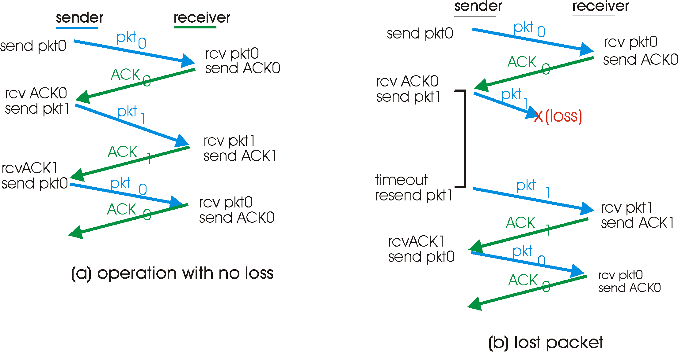
rdt3.0 in action

Slide 43
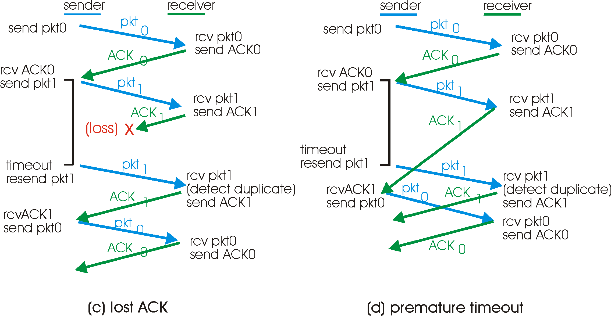
rdt3.0 in action
Because packet sequence numbers alternate between 0 and 1,
rdt3.0 is sometimes known as the alternating-bit protocol.
Notes:
We have now assembled the key elements of a data transfer protocol.
Checksums, sequence numbers, timers, and positive and negative acknowledgment packets
each play a crucial and necessary role in the operation of the protocol. We now
have a working reliable data transfer protocol!
Figure 3.16, time moves forward from the top of the diagram toward the bottom of the
Diagram.
Because packet sequence numbers alternate between 0 and 1,
protocol rdt3.0 is sometimes known as the alternating-bit protocol.

Slide 44
Performance of rdt3.0
RTT (Round-trip Time) = 15x2 = 30 msec
rdt3.0 works, but performance stinks
ex: 1 Gbps link, 15 millisec prop. delay, 8000 bit packet:
U _{sender}: utilization – fraction of time sender busy sending
1KB pkt every 30 msec -> 33kB/sec thruput over 1 Gbps link
network protocol limits use of physical resources!

Slide 45
rdt3.0: stop-and-wait operation
sender
receiver
first packet bit transmitted, t = 0
last packet bit transmitted, t = L / R
first packet bit arrives
RTT
last packet bit arrives, send ACK
ACK arrives, send next
packet, t = RTT + L / R

Slide 46
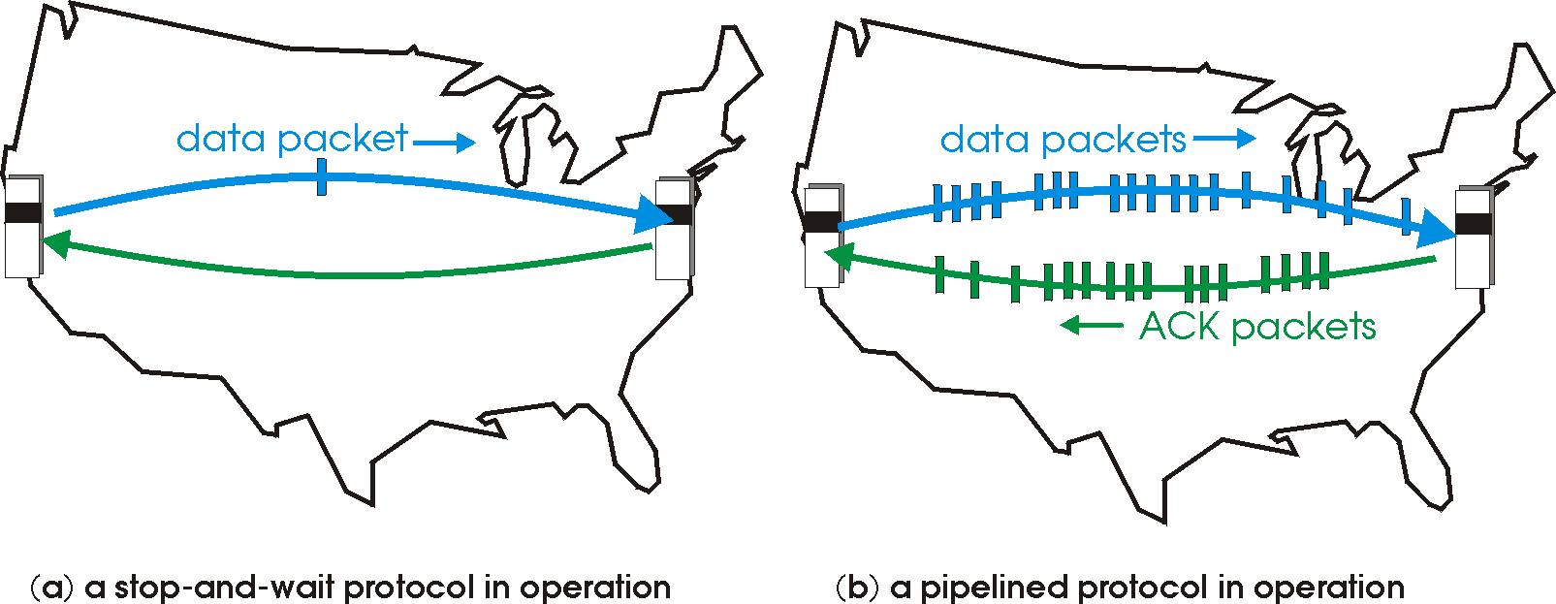
Pipelined protocols
Pipelining: sender allows multiple, “in-flight”, yet-to-be-acknowledged pkts
range of sequence numbers must be increased
buffering at sender and/or receiver
Two generic forms of pipelined error recovery protocols: go-Back-N, selective repeat

Slide 47
Pipelining: increased utilization
sender
receiver
first packet bit transmitted, t = 0
last bit transmitted, t = L / R
first packet bit arrives
RTT
last packet bit arrives, send ACK
last bit of 2nd packet arrives, send ACK
last bit of 3rd packet arrives, send ACK
ACK arrives, send next
packet, t = RTT + L / R
Increase utilization
by a factor of 3!

Slide 48
Pipelining Protocols
Go-back-N: big picture:
Sender can have up to N unacked packets in pipeline
Rcvr only sends cumulative acks
Ack (n) acks the successful arrival of packets whose seq num are less than or equal to n
Doesn’t ack packet if there’s a gap
Sender has timer for oldest unacked packet
If timer expires, retransmit all unacked packets
Selective Repeat: big pic
Sender can have up to N unacked packets in pipeline
Rcvr acks individual packets
Ack (n) only acks the arrival of a packet with seq num n
Sender maintains timer for each unacked packet
When timer expires, retransmit only unack packet

Slide 49
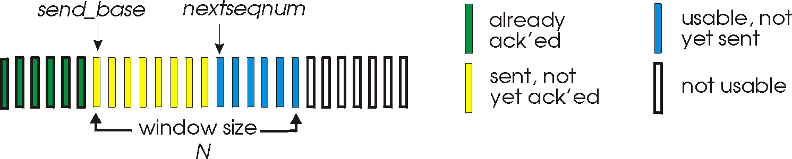
Go-Back-N (sliding window protocol)
Sender:
k-bit seq # in pkt header
“window” of up to N, consecutive unack’ed pkts allowed
ACK(n): ACKs all pkts up to, including seq # n - “cumulative ACK”
may receive duplicate ACKs (see receiver)
timer for oldest acked pkt
timeout(n): retransmit pkt n and all higher (or unacked) seq # pkts in window

Slide 50
GBN: sender extended FSM
rdt_send(data)
if (nextseqnum < base+N) {
sndpkt[nextseqnum] = make_pkt(nextseqnum,data,chksum)
udt_send(sndpkt[nextseqnum])
if (base == nextseqnum)
start_timer
nextseqnum++
}
else
refuse_data(data)
Λ
base=1
nextseqnum=1
timeout
Wait
start_timer
udt_send(sndpkt[base])
udt_send(sndpkt[base+1])
…
udt_send(sndpkt[nextseqnum-1])
rdt_rcv(rcvpkt)
&& corrupt(rcvpkt)
rdt_rcv(rcvpkt) &&
notcorrupt(rcvpkt)
base = getacknum(rcvpkt)+1
If (base == nextseqnum)
stop_timer
else
start_timer

Slide 51
GBN: receiver extended FSM
default
udt_send(sndpkt)
rdt_rcv(rcvpkt)
&& notcurrupt(rcvpkt)
&& hasseqnum(rcvpkt,expectedseqnum)
Λ
Wait
extract(rcvpkt,data)
deliver_data(data)
sndpkt = make_pkt(expectedseqnum,ACK,chksum)
udt_send(sndpkt)
expectedseqnum++
expectedseqnum=1
sndpkt =
make_pkt(expectedseqnum,ACK,chksum)
ACK-only: always send ACK for correctly-received pkt with highest in-order seq #
may generate duplicate ACKs
need only remember expectedseqnum
out-of-order pkt:
discard (don’t buffer) -> no receiver buffering!
Re-ACK pkt with highest in-order seq #

Slide 52
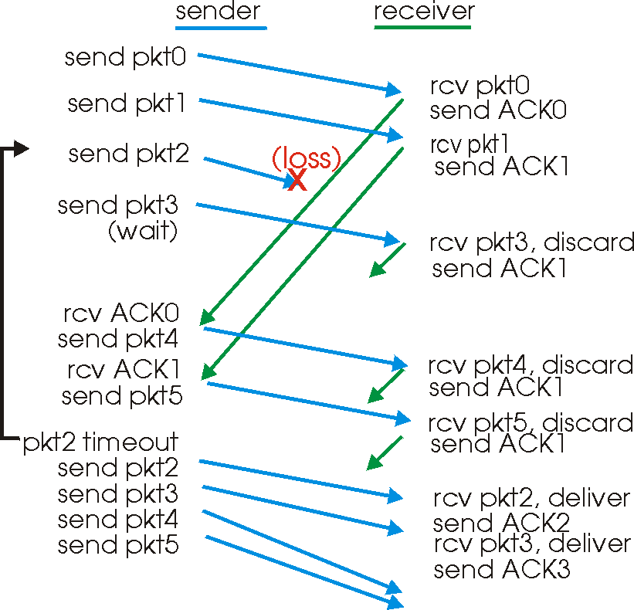
GBN in action
0 | 1 | 2 | 3 | 4 | 5 | 6
0 | 1 | 2 | 3 | 4 | 5 | 6
0 | 1 | 2 | 3 | 4 | 5 | 6
0 | 1 | 2 | 3 | 4 | 5 | 6
Window size = 4
0 | 1 | 2 | 3 | 4 | 5 | 6
0 | 1 | 2 | 3 | 4 | 5 | 6

Slide 53
Selective Repeat (SR)
receiver individually acknowledges all correctly received pkts
buffers pkts, as needed, for eventual in-order delivery to upper layer
sender only resends pkts for which ACK not received
sender timer for each unACKed pkt
sender window
N consecutive seq #’s
again limits seq #s of sent, unACKed pkts

Slide 54
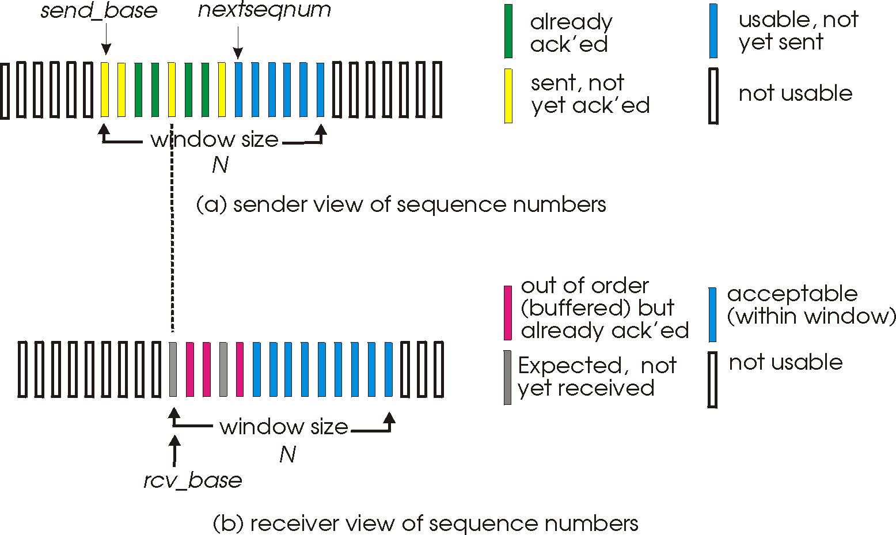
Selective repeat: sender, receiver windows

Slide 55
Selective repeat
sender
receiver
data from above :
if next available seq # in window, send pkt
timeout(n):
resend pkt n, restart timer
ACK(n) in [sendbase,sendbase+N]:
mark pkt n as received
if n smallest unACKed pkt, advance window base to next unACKed seq #
pkt n in [rcvbase, rcvbase+N-1]
send ACK(n)
out-of-order: buffer
in-order: deliver (also deliver buffered, in-order pkts), advance window to next not-yet-received pkt
pkt n in [rcvbase-N,rcvbase-1]
ACK(n)
otherwise:
ignore

Slide 56
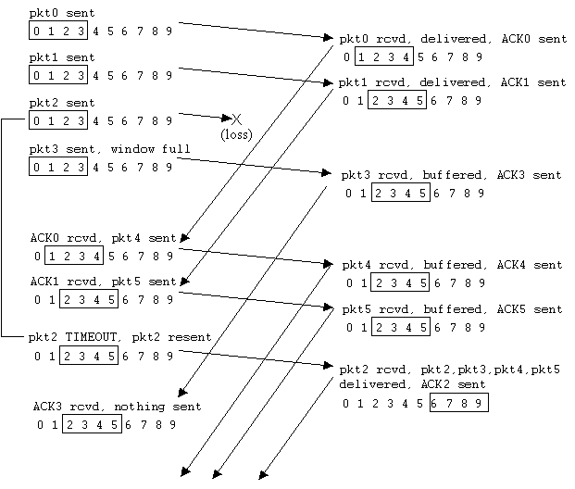
Selective repeat in action

Slide 57
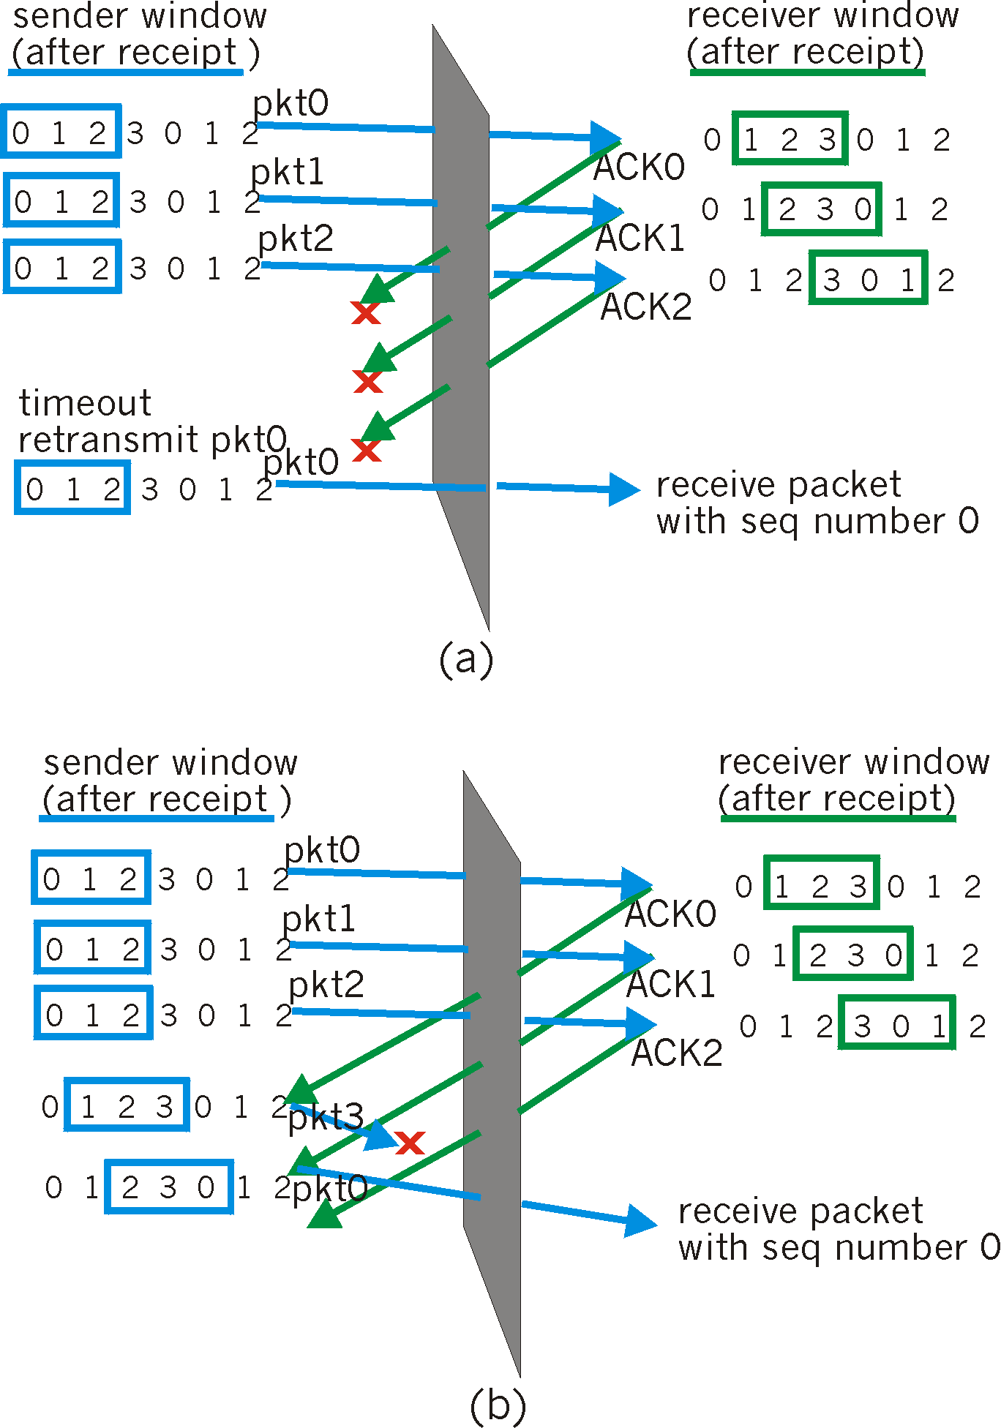
SR receiver dilemma with too-large windows: A new packet or a retransmission?
Example:
four seq #’s: 0, 1, 2, 3
window size=3
receiver sees no difference in two scenarios!
incorrectly passes duplicate data as new in (a)
Q: what relationship between seq # size and window size?
A : 2 ^{n-1}
window size <= half of seq # size

Slide 58
Unit 4 outline
4.1 Transport-layer services
4.2 Multiplexing and demultiplexing
4.3 Connectionless transport: UDP
4.4 Principles of reliable data transfer
4.5 Connection-oriented transport: TCP
segment structure
reliable data transfer
flow control
connection management
4.6 Principles of congestion control
4.7 TCP congestion control

Slide 59
TCP: Overview RFCs: 793, 1122, 1323, 2018, 2581
point-to-point:
one sender, one receiver
reliable, in-order byte stream:
no “message boundaries”
pipelined:
TCP congestion and flow control set window size
send & receive buffers
full duplex data:
bi-directional data flow in same connection
MSS: maximum segment size
connection-oriented:
handshaking (exchange of control msgs) init’s sender, receiver state before data exchange
flow controlled:
sender will not overwhelm receiver
Notes:
The maximum amount of data that can be grabbed and placed in a
segment is limited by the maximum segment size (MSS). The MSS is typically set
by first determining the length of the largest link-layer frame that can be sent by the
local sending host (the so-called maximum transmission unit, MTU), and then
setting the MSS to ensure that a TCP segment (when encapsulated in an IP
datagram) will fit into a single link-layer frame. Common values for the MTU are 1,460
bytes, 536 bytes, and 512 bytes.

Slide 60
Unit 4 outline
4.1 Transport-layer services
4.2 Multiplexing and demultiplexing
4.3 Connectionless transport: UDP
4.4 Principles of reliable data transfer
4.5 Connection-oriented transport: TCP
segment structure
reliable data transfer
flow control
connection management
4.6 Principles of congestion control
4.7 TCP congestion control

Slide 61
TCP segment structure
32 bits
counting
by bytes
of data
(not segments!)
URG: urgent data
(generally not used)
source port #
dest port #
sequence number
ACK: ACK #
valid
acknowledgement number
head
len
not
used
U
Receive window
20-byte fixed length header
A
P
R
S
PSH: push data now
(generally not used)
F
checksum
Urg data pointer
# bytes
rcvr willing
to accept
RST, SYN, FIN:
connection estab
(setup, teardown
commands)
Options (variable length)
Init. Def.: MSS
application
data
(variable length)
Internet
checksum
(as in UDP)
Notes:
MSS=maximum segment size

Slide 62
Sequence number counting the number of bytes
Notes:
In Figure 3.30, we assumed that the initial sequence number was zero. In truth,
both sides of a TCP connection randomly choose an initial sequence number. This is
done to minimize the possibility that a segment that is still present in the network
from an earlier, already-terminated connection between two hosts is mistaken for a
valid segment in a later connection between these same two hosts

Slide 63
TCP seq. #’s and ACKs
Seq. #’s:
byte stream “number” of first byte in segment’s data
ACKs:
seq # of next byte expected from other side
cumulative ACK
Q: how receiver handles out-of-order segments
A: TCP spec doesn’t say, - up to implementor
Host A
(client)
Host B
(server)
User
types
‘C’
Seq=42, ACK=79, data = ‘C’
host ACKs
receipt of
‘C’, echoes
back ‘C’
Seq=79, ACK=43, data = ‘C’
host ACKs
receipt
of echoed
‘C’
Seq=43, ACK=80
time
simple telnet scenario

Slide 64
TCP Round Trip Time and Timeout
Q: how to set TCP timeout value?
longer than RTT
but RTT varies
too short: premature timeout
unnecessary retransmissions
too long: slow reaction to segment loss
Q: how to estimate next RTT?
SampleRTT: measured time from segment transmission until ACK receipt
ignore retransmissions
SampleRTT will vary, want estimated RTT “smoother”
average several recent measurements (called EstimatedRTT), not just current SampleRTT

Slide 65
TCP Round Trip Time and Timeout
EstimatedRTT(n) = (1- α)*EstimatedRTT(n-1) + α*SampleRTT(n)
When nth measurement is done
Exponential weighted moving average (EWMA)
influence of past sample decreases exponentially fast
typical value: α = 0.125

Slide 66
Example RTT estimation:

Slide 67
TCP Round Trip Time and Timeout
Setting the timeout
EstimtedRTT plus “safety margin”
large variation in EstimatedRTT -> larger safety margin
first estimate of how much SampleRTT deviates from EstimatedRTT:
DevRTT = (1-β)*DevRTT +
β*|SampleRTT-EstimatedRTT|
(typically, β = 0.25)
Then set timeout interval:
TimeoutInterval = EstimatedRTT + 4*DevRTT

Slide 68
Unit 4 outline
4.1 Transport-layer services
4.2 Multiplexing and demultiplexing
4.3 Connectionless transport: UDP
4.4 Principles of reliable data transfer
4.5 Connection-oriented transport: TCP
segment structure
reliable data transfer
flow control
connection management
4.6 Principles of congestion control
4.7 TCP congestion control

Slide 69
TCP reliable data transfer
TCP creates rdt service on top of IP’s unreliable service
Pipelined segments
Cumulative acks
TCP uses single retransmission timer
Retransmissions are triggered by:
timeout events
duplicate acks
Initially consider simplified TCP sender:
ignore duplicate acks
ignore flow control, congestion control

Slide 70
TCP sender events:
data rcvd from app:
Create segment with seq #
seq # is byte-stream number of first data byte in segment
start timer if not already running (think of timer as for oldest unacked segment)
expiration interval: TimeOutInterval
timeout:
retransmit segment that caused timeout
restart timer
Ack rcvd:
If acknowledges previously unacked segments
update what is known to be acked
start timer if there are outstanding, unacked segments
Notes:
outstanding 搜索网络
英 [aʊtˈstændɪŋ] 美 [aʊtˈstændɪŋ, ˈaʊtˌstæn-]
adj. 杰出的; 显著的; 凸出的; 未完成的;

Slide 71
TCP sender (simplified)
NextSeqNum = InitialSeqNum
SendBase = InitialSeqNum
loop (forever) {
switch(event)
event: data received from application above
create TCP segment with sequence number NextSeqNum
if (timer currently not running)
start timer
pass segment to IP
NextSeqNum = NextSeqNum + length(data)
event: timer timeout
retransmit not-yet-acknowledged segment with
smallest sequence number
start timer
event: ACK received, with ACK field value of y
if (y > SendBase) {
SendBase = y
if (there are currently not-yet-acknowledged segments)
start timer
}
} /* end of loop forever */
Comment:
SendBase-1: last
cumulatively ack’ed byte
Example:
SendBase-1 = 71; y= 73, so the rcvr wants 73+ ; y > SendBase, so that new data is acked

Slide 72
TCP: retransmission scenarios
Host A
Host B
Host A
Host B
Seq=92, 8 bytes data
Seq=92, 8 bytes data
Seq=100, 20 bytes data
timeout
ACK=100
Seq=92 timeout
X
ACK=100
loss
ACK=120
Seq=92, 8 bytes data
Sendbase
= 100
Seq=92, 8 bytes data
SendBase
= 120
Seq=92 timeout
ACK=120
ACK=100
SendBase
= 100
SendBase
= 120
premature timeout
segment 100 not retransmitted
time
time
lost ACK scenario
Notes:
event: timer timeout
retransmit not-yet-acknowledged segment with
smallest sequence number
start timer

Slide 73
TCP retransmission scenarios (more)
Host A
Host B
Seq=92, 8 bytes data
ACK=100
timeout
Seq=100, 20 bytes data
X
loss
SendBase
= 120
ACK=120
time
Cumulative ACK scenario
avoid retransmission of the first segment
Notes:
event: ACK received, with ACK field value of y
if (y > SendBase) {
SendBase = y
if (there are currently not-yet-acknowledged segments)
start timer
}

Slide 74
TCP ACK generation [RFC 1122, RFC 2581]
Event at Receiver
Arrival of in-order segment with
expected seq #. All data up to
expected seq # already ACKed
Arrival of in-order segment with
expected seq #. One other
segment has ACK pending
Arrival of out-of-order segment
higher-than-expect seq. # .
Gap detected
Arrival of segment that
partially or completely fills gap
TCP Receiver action
Delayed ACK. Wait up to 500ms
for next segment. If no next segment,
send ACK
Immediately send single cumulative
ACK, ACKing both in-order segments
Immediately send duplicate ACK,
indicating seq. # of next expected byte
Immediate send ACK, provided that
segment starts at lower end of gap

Slide 75
Fast Retransmit
Time-out period often relatively long:
long delay before resending lost packet
Detect lost segments via duplicate ACKs.
Sender often sends many segments back-to-back
If segment is lost, there will likely be many duplicate ACKs.
If sender receives 3 ACKs for the same data, it supposes that segment after ACKed data was lost:
fast retransmit: resend segment before timer expires
Notes:
Since TCP does not use negative acknowledgments, the receiver
cannot send an explicit negative acknowledgment back to the sender. Instead, it
simply reacknowledges (that is, generates a duplicate ACK for) the last in-order byte of
data it has received. (Note that Table 3.2 allows for the case that the receiver does
not discard out-of-order segments.)

Slide 76
Host A
Host B
Send M₁
Send M₂
Send M₃
Send M₄
X
ACK M₁
Send M₅
ACK M₁
ACK M₁
Triple duplicate ACK
ACK M₁
timeout
resend M₂
time
Figure 3.37 Resending a segment after triple duplicate ACK

Slide 77
Fast retransmit algorithm:
event: ACK received, with ACK field value of y
if (y > SendBase) {
SendBase = y
if (there are currently not-yet-acknowledged segments)
start timer
}
else {
increment count of dup ACKs received for y
if (count of dup ACKs received for y = 3) {
resend segment with sequence number y
}
a duplicate ACK for
already ACKed segment
fast retransmit

Slide 78
Unit 4 outline
4.1 Transport-layer services
4.2 Multiplexing and demultiplexing
4.3 Connectionless transport: UDP
4.4 Principles of reliable data transfer
4.5 Connection-oriented transport: TCP
segment structure
reliable data transfer
flow control
connection management
4.6 Principles of congestion control
4.7 TCP congestion control

Slide 79
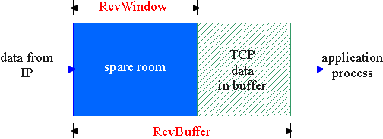
TCP Flow Control
flow control
sender won’t overflow
receiver’s buffer by
transmitting too much,
too fast
receive side of TCP connection has a receive buffer:
speed-matching service: matching the send rate to the receiving app’s drain rate
app process may be slow at reading from buffer
Notes:
Because TCP is not permitted to overflow the allocated buffer, we must have
LastByteRcvd — LastByteRead ^ RcvBuffer
The receive window, denoted rwnd is set to the amount of spare room in the buffer:
rwnd = RcvBuffer — [LastByteRcvd — LastByteRead]

Slide 80
TCP Flow control: how it works
Rcvr advertises spare room by including value of RcvWindow in segments
Sender limits unACKed data to RcvWindow
guarantees receive buffer doesn’t overflow
(Suppose TCP receiver discards out-of-order segments)
spare room in buffer
= RcvWindow
= RcvBuffer-[LastByteRcvd - LastByteRead]

Slide 81
Unit 4 outline
4.1 Transport-layer services
4.2 Multiplexing and demultiplexing
4.3 Connectionless transport: UDP
4.4 Principles of reliable data transfer
4.5 Connection-oriented transport: TCP
segment structure
reliable data transfer
flow control
connection management
4.6 Principles of congestion control
4.7 TCP congestion control

Slide 82
TCP Connection Management
Recall: TCP sender, receiver establish “connection” before exchanging data segments
initialize TCP variables:
seq. #s
buffers, flow control info (e.g. RcvWindow)
client: connection initiator
Socket clientSocket = new Socket("hostname","port number");
server: contacted by client
Socket connectionSocket = welcomeSocket.accept();
Three way handshake:
Step 1: client host sends TCP SYN segment to server
specifies initial seq #
no data
Step 2: server host receives SYN, replies with SYNACK segment
server allocates buffers
specifies server initial seq. #
Step 3: client receives SYNACK, replies with ACK segment, which may contain data

Slide 83
Three-Way Handshaking
TCP’s active open
TCP’s passive open
Closed
Closed
ACK=0, no data
seq=client_isn
LISTEN
SYN-SENT
ACK=1, no data
SYN-RCVD
ACK=1, with/without data
seq=client_isn
ESTABLISHED
DATA Transmission
ESTABLISHED
Notes:
The client randomly chooses an initial sequence number (client_isn) and puts
this number in the sequence number field of the initial TCP SYN segment.
There has been considerable interest in properly randomizing the choice of the
client_isn in order to avoid certain security attacks [CERT 2001-09].

Slide 84
TCP Connection Management (cont.)
Closing a connection:
client closes socket: clientSocket.close();
Step 1: client end system sends TCP FIN control segment to server
Step 2: server receives FIN, replies with ACK. Closes connection, sends FIN.
client
server
close
FIN
ACK
close
FIN
ACK
timed wait
closed

Slide 85
TCP Connection Management (cont.)
Step 3: client receives FIN, replies with ACK.
Enters “timed wait” - will respond with ACK to received FINs
Wait for timed wait interval for outstanding packets to get out of the network
Step 4: server, receives ACK. Connection closed.
Note: with small modification, can handle simultaneous FINs.
client
server
closing
FIN
ACK
closing
FIN
ACK
timed wait
closed
closed
Notes:
outstanding
英 [aʊtˈstændɪŋ] 美 [aʊtˈstændɪŋ, ˈaʊtˌstæn-]
adj.杰出的； 显著的； 凸出的； 未完成的

Slide 86
Client
Server
A
B
ESTAB-
LISHED
Data
Transmission
Inform
app
Request
close
ESTAB-
LISHED
FIN = 1, seq = u
FIN-
WAIT-1
ACK = 1, seq = v, ack= u + 1
CLOSE-
WAIT
Data Transmission
Closed
passively
FIN-
WAIT-2
FIN = 1, ACK = 1, seq = w, ack= u + 1
LAST-
ACK
wait 2MSL
ACK = 1, seq = u + 1, ack = w + 1

TIME-
WAIT
CLOSED
CLOSED
MSL – Maximum Segment Lifetime
Notes:
Suppose that the client application decides it wants to close the connection.
(Note that the server could also choose to close the connection.) This causes the
client TCP to send a TCP segment with the FIN bit set to 1 and to enter the
F1N_WAIT_1 state. While in the FIN_WAIT_1 state, the client TCP waits for a TCP
segment from the server with an acknowledgment. When it receives this segment,
the client TCP enters the FIN_WAIT_2 state. While in the FIN_WAIT_2 state, the
client waits for another segment from the server with the FIN bit set to 1; after
receiving this segment, the client TCP acknowledges the server's segment and
enters the TIME_WAIT state. The TIME_WAIT state lets the TCP client resend the
final acknowledgment in case the ACK is lost. The time spent in the TIME_WAIT
state is implementation-dependent, but typical values are 30 seconds, 1 minute, and
2 minutes. After the wait, the connection formally closes and all resources on the
client side (including port numbers) are released.

Slide 87
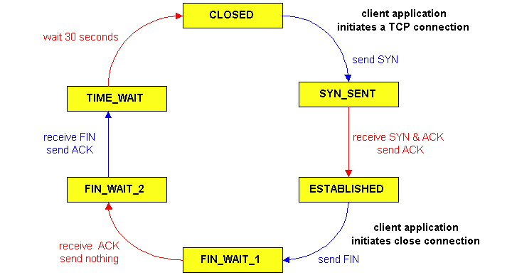
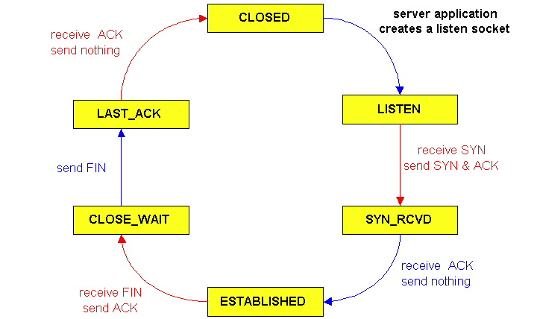
TCP Connection Management (cont)
TCP server
lifecycle
TCP client
lifecycle

Slide 88
Unit 4 outline
4.1 Transport-layer services
4.2 Multiplexing and demultiplexing
4.3 Connectionless transport: UDP
4.4 Principles of reliable data transfer
4.5 Connection-oriented transport: TCP
segment structure
reliable data transfer
flow control
connection management
4.6 Principles of congestion control
4.7 TCP congestion control

Slide 89
Principles of Congestion Control
Congestion:
informally: “too many sources sending too much data too fast for network to handle”
e.g., different sources compete for “common” or “shared” resources inside network
different from flow control!
manifestations:
lost packets (buffer overflow at routers)
long delays (queuing in router buffers)
a top-10 problem!

Slide 90
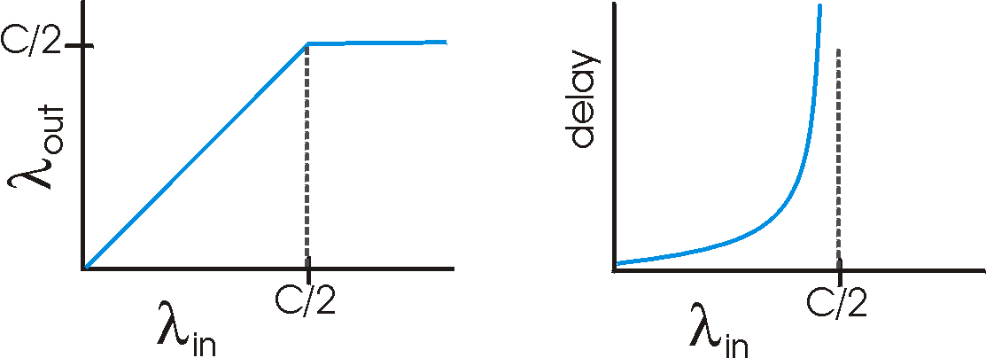
Causes/costs of congestion: scenario 1
two senders, two receivers
one router, infinite buffers
no retransmission
Host A
λ_{in} : original data
λ_{out}
λ_{in} : original data
Host B
unlimited shared output link buffers
Shared link capacity C
large (queuing) delays when congested
maximum achievable throughput
Per connection throughput and delay as a function of host sending rate
Notes:
Let's assume that the application in Host A is sending data into the connection
(for example, passing data to the transport-level protocol via a socket) at an average
rate of Xin bytes/sec. These data are original in the sense that each unit of data is sent
into the socket only once. The underlying transport-level protocol is a simple one.
Data is encapsulated and sent; no error recovery (for example, retransmission), flow
control, or congestion control is performed. Ignoring the additional overhead due to
Adding tansport- and lower-layer header information, the rate at which Host A offers
traffic to the router in this first scenario is thus Xin bytes/sec. Host B operates in a
similar manner, and we assume for simplicity that it too is sending at a rate of \in
bytes/sec. Packets from Hosts A and B pass through a router and over a shared outgoing link of capacity C.
When the sending rate is above C/2, however, the throughput is only C/2. This upper
limit on throughput is a consequence of the sharing of link capacity between two
connections.
When the sending rate exceeds R/2, the
average number of queued packets in the router is unbounded, and the average delay
between source and destination becomes infinite (assuming that the connections
operate at these sending rates for an infinite period of time and there is an infinite
amount of buffering available). Thus, while operating at an aggregate throughput of
near/? may be ideal from a throughput standpoint, it is far from ideal from a delay
standpoint. Even in this (extremely) idealized scenario we’ve already found one
cost of a congested network—large queuing delays are experienced as the packet-
arrival rate nears the link capacity.

Slide 91
Causes/costs of congestion: scenario 2
one router, finite buffers
sender retransmission of lost packet
Host A
λ_{in} : original data
λ_{out}
λ'_{in} : original data + retransmitted data = offered load
Host B
finite shared output link buffers
Shared link capacity C
Notes:
撇号
piēhào
[prime] 在书写或印刷中所加的符号或重音“'”,以区别一个字母和另一个有关的字母(以a'区别a或a"),或指明有关的单位(如角度的分或米)或区分一种数学功能
Let us now slightly modify scenario 1 in the following two ways (see Figure 3.45).
First, the amount of router buffering is assumed to be finite. A consequence of this
real-world assumption is that packets will be dropped when arriving to an already-
full buffer. Second, we assume that each connection is reliable. If a packet
containing a transport-level segment is dropped at the router, the sender will eventually
retransmit it. Because packets can be retransmitted, we must now be more careful
with our use of the term sending rate. Specifically, let us again denote the rate at
which the application sends original data into the socket by Xin bytes/sec. The rate at
which the transport layer sends segments (containing original data and
retransmitted data) into the network will be denoted X[n bytes/sec. X[n is sometimes referred to
as the offered load to the network.

Slide 92
Causes/costs of congestion: scenario 2
λ
λ
always: (goodput)
“perfect” retransmission only when loss:
retransmission of delayed (not lost) packet makes larger (than perfect case) for same
=
in
out
λ
>
λ
in
out
λ
in
λ
out
C/2
C/2
C/2
R/2
R/2
Retrans
data
R/2
C/3
R/3
λ_{out}
λ_{out}
λ_{out}
λ_{out}
C/4
Original data
R/4
R/2
R/2
R/2
λ_{in}
C/2
λ_{in}
C/2
λ_{in}
C/2
Ideal no packet loss
packet loss
Delayed packets
a.
b.
c.
“costs” of congestion:
more work (retrans) for given “goodput”
unneeded retransmissions: link carries multiple copies of pkt
Notes:
We see here another cost of a congested
network—the sender must perform retransmissions in order to compensate for dropped
(lost) packets due to buffer overflow.

Slide 93
Causes/costs of congestion: scenario 3
four senders with same λ_{in}
routers with finite buffers
multihop paths
timeout/retransmit
Q: what happens as λ_{in} and λ’_{in} increase?
Host A
λ_{in} : original data
λ_{out}
λ'_{in} : original data, plus retransmitted data
finite shared output link buffers
R₁
Shared link capacity C
Shared link capacity C
Host B
R₄
Shared link capacity C
R₂
R₃
Shared link capacity C

Slide 94
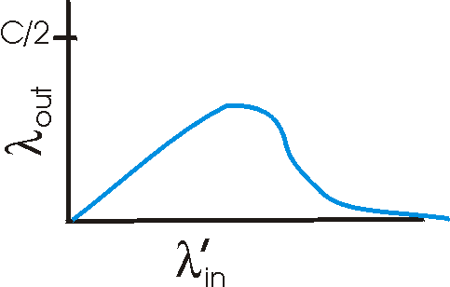
Causes/costs of congestion: scenario 3
Host A
λ_{out}
Host B
Another “cost” of congestion:
when packet dropped, any “upstream” transmission capacity used for that packet was wasted!
Notes:
The reason for the eventual decrease in throughput with increasing offered load
is evident when one considers the amount of wasted work done by the network. In
the high-traffic scenario outlined above, whenever a packet is dropped at a second-
hop router, the work done by the first-hop router in forwarding a packet to the
second-hop router ends up being "wasted." The network would have been equally well
off (more accurately, equally bad off) if the first router had simply discarded that
packet and remained idle. More to the point, the transmission capacity used at the
first router to forward the packet to the second router could have been much more
profitably used to transmit a different packet. (For example, when selecting a packet
for transmission, it might be better for a router to give priority to packets that have
already traversed some number of upstream routers.) So here we see yet another cost
of dropping a packet due to congestion—when a packet is dropped along a path, the
transmission capacity that was used at each of the upstream links to forward that
packet to the point at which it is dropped ends up having been wasted,

Slide 95
Function of congestion control
Effective throughput
Perfect congestion control
Realistic congestion control
No congestion control
deadlock
load
0
Light
congestion
congestion

Slide 96
Congestion Collapse
Definition: Increase in network load results in decrease of useful work done
Many possible causes
Retransmissions of packets still in flight
Undelivered packets
Packets consume resources and are dropped elsewhere in network
Fragments
Mismatch of transmission and retransmission units
Control traffic
Large percentage of traffic is for control
Stale or unwanted packets
Packets that are delayed on long queues

Slide 97
Static solutions
Q: Will the “congestion” problem be solved when:
a) Memory becomes cheap (infinite memory)?
No buffer
Too late
b) Links become cheap (high speed links)?
All links 19.2 kb/s
Replace with 1 Mb/s
S
S
S
S
S
S
S
S
File Transfer time = 5 mins
File Transfer Time = 7 hours
Transport Layer

Slide 98
Static solutions (more)
c) Processors become cheap (fast routers & switches)
A
C
S
B
D
Scenario: All links 1 Gb/s.
A & B send to C
=> “high-speed” congestion!!
(lose more packets faster!)

Slide 99
Approaches towards congestion control
Two broad approaches towards congestion control:
End-end congestion control:
no explicit feedback from network
congestion inferred from end-system observed loss, delay
approach taken by TCP
Network-assisted congestion control:
routers provide feedback to end systems
single bit indicating congestion (IBM SNA, DECbit, TCP/IP ECN, ATM)
explicit rate sender should send at
Notes:
• End-to-end congestion control. In an end-to-end approach to congestion control.
the network layer provides no explicit support to the transport layer for congestion-
control purposes. Even the presence of congestion in the network must be infernJ
by the end systems based only on observed network behavior (for example, packet
loss and delay). We will see in Section 3.7 that TCP must necessarily take this end-
to-end approach toward congestion control, since the IP layer provides no feedback
to the end systems regarding network congestion. TCP segment loss (as indicated
by a timeout or a triple duplicate acknowledgment) is taken as an indication of network congestion and TCP decreases its window size accordingly. We will also «x
a more recent proposal for TCP congestion control that uses increasing round-trip
delay values as indicators of increased network congestion.

Slide 100
Unit 4 outline
4.1 Transport-layer services
4.2 Multiplexing and demultiplexing
4.3 Connectionless transport: UDP
4.4 Principles of reliable data transfer
4.5 Connection-oriented transport: TCP
segment structure
reliable data transfer
flow control
connection management
4.6 Principles of congestion control
4.7 TCP congestion control

Slide 101
TCP Congestion Control: details
congestion window (cwnd) = send window
sender limits transmission:
LastByteSent-LastByteAcked
≤ min{cwnd, rwnd}
Roughly, send rate:
cwnd is dynamic, function of perceived network congestion
How does sender perceive congestion?
loss event = timeout or 3 duplicate acks
TCP sender reduces rate (cwnd) after loss event
three mechanisms:
AIMD
slow start
conservative after timeout events
cwnd
rate =
Bytes/sec
RTT
Notes:
In order to focus on congestion control (as opposed to flow control), let us
henceforth assume that the TCP receive buffer is so large that the receive-window
constraint can be ignored; thus, the amount of unacknowledged data at the sender is
solely limited by cwnd. We will also assume that the sender always has data to
send, i.e., that all segments in the congestion window are sent.
The constraint above limits the amount of unacknowledged data at the sender
and therefore indirectly limits the sender's send rate. To see this, consider a
connection for which loss and packet transmission delays are negligible. Then, roughly, at
the beginning of every RTT, the constraint permits the sender to send cwnd bytes of
data into the connection; at the end of the RTT the sender receives
acknowledgments for the data. Thus the sender's send rate is roughly cwnd/RTTbytes/sec. By
adjusting the value of cwnd, the sender can therefore adjust the rate at which it
sends data into its connection.

Slide 102
Additive Increase, Multiplicative Decrease (AIMD)
Approach: increase transmission rate (window size), probing for usable bandwidth, until loss occurs
additive increase: increase cwnd by 1 MSS every RTT until loss detected (Congestion avoidance)
multiplicative decrease: cut cwnd in half after loss
Saw tooth
behavior: probing
for bandwidth
congestion window size
time
Notes:
MSS: maximum segment size

Slide 103
TCP Slow Start
When connection begins, cwnd = 1 MSS
Example: MSS = 500 bytes & RTT = 200 msec
initial rate = 20 kbps
available bandwidth may be >> MSS/RTT
desirable to quickly ramp up to respectable rate
When connection begins, increase rate exponentially until first loss event:
double cwnd every RTT
done by incrementing cwnd for every ACK received
Summary: initial rate is slow but ramps up exponentially fast
Notes:
ramp
[rAmp]
n.
斜坡, 坡道, 敲诈
vi.
狂跳乱撞, 敲诈, 蔓延
vt.
使有斜面, 敲诈

Slide 104
TCP Slow Start (more)
sender
receiver
Host A
Host B
cwnd = 1
M₁
RTT
ACK M₁
round 1
cwnd = 2
M₂~M₃
ACK M₂~M₃
round 2
cwnd = 4
M₄~M₇
ACK M₄~M₇
round 3
cwnd = 8
M₈~M₁₅
…
t
t

Slide 105



Refinement: inferring loss
Philosophy:
After 3 dup ACKs
(fast retransmit):
cwnd is cut in half
window then grows linearly
But after timeout event:
cwnd instead set to 1 MSS;
window then grows exponentially
to a threshold, then grows linearly
3 dup ACKs indicates network capable of delivering some segments
timeout indicates a “more alarming” congestion scenario
Notes:
infer
[in5fE:]
v.
推断

Slide 106
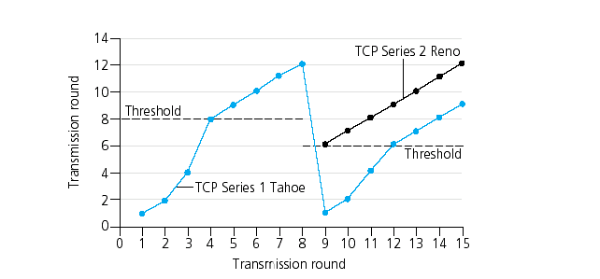
Refinement
congestion avoidance (CA), additive increase (AI)
Q: When should the exponential increase switch to linear?
A: When cwnd gets to 1/2 of its value before timeout.
fast retransmit
loss occurs
multiplicative decrease
cwnd
fast recovery
Implementation:
Variable Threshold
At loss event, Threshold is set to 1/2 of cwnd just before loss event
Slow start
Slow start

Slide 107
Congestion: A Close-up View
knee
cliff
packet
loss
knee – point after which
throughput increases very slowly
delay increases fast
cliff – point after which
throughput starts to decrease very fast to zero (congestion collapse)？
delay approaches infinity
Throughput
congestion
collapse
Load
Delay
Load
Notes:
Throughput 吞吐量

Slide 108
Congestion Control vs. Congestion Avoidance
Congestion control goal
stay left of cliff
response to the occurred network overload
Congestion avoidance goal
stay left of knee
detection and prevention actions before overload occur
Congestion collapse
right of cliff
knee
cliff
Throughput
congestion
collapse
Load

Slide 109
Summary: TCP Congestion Control
When cwnd is below Threshold, sender in slow-start phase, window grows exponentially.
When cwnd is above Threshold, sender is in congestion-avoidance phase, window grows linearly.
When a triple duplicate ACK occurs, Threshold set to cwnd/2 and cwnd set to Threshold.
When timeout occurs, Threshold set to cwnd/2 and cwnd is set to 1 MSS.

Slide 110
TCP sender congestion control
State | Event | TCP Sender Action | Commentary
Slow Start (SS) | ACK receipt for previously unacked data | cwnd = cwnd+MSS * (cwnd/MSS), If (cwnd > Threshold) set state to “Congestion Avoidance” | Resulting in a doubling of cwnd every RTT
Congestion Avoidance (CA) | ACK receipt for previously unacked data | cwnd = cwnd + MSS | Additive increase, resulting in increase of cwnd by 1 MSS every RTT
SS or CA | Loss event detected by triple duplicate ACK | Threshold = cwnd/2, cwnd = Threshold, Set state to “Congestion Avoidance” | Fast recovery, implementing multiplicative decrease. cwnd will not drop below 1 MSS.
SS or CA | Timeout | Threshold = cwnd/2, cwnd = 1 MSS, Set state to “Slow Start” | Enter slow start
SS or CA | Duplicate ACK | Increment duplicate ACK count for segment being acked | cwnd and Threshold not changed

Slide 111
Congestion, Tail Drop and TCP
Tail-drop policy used by early routers has a significant effect on TCP congestion control
a single TCP connection pass through a router, the loss causes TCP to enter slow-start; after receiving ACKs, increase the congestion window
Realistically, many TCP connections in a network pass through a router, the loss may cause the same procedure for all connections and lead to global synchronization
Reasons:
datagrams are typically multiplexed
under a tail-drop policy, the router will discard one segment from N connections rather than N segments from one connection
the simultaneous loss causes all N instances of TCP to enter slow-start at the same time (throughput decreases suddenly)
after the network recovers, throughput will suddenly increase a lot
Network layer

Slide 112
Random early detection (RED)
Q: How can a router avoid tail-drop and global synchronization?
A: RED (instead of waiting until the queue overflows, a router slowly and randomly drops datagrams as congestion increases)
discard
discard with probability p
queuing
packets arrive
sent from the head of a queue
TH_{min}
Average queue length L_{av}
TH_{max}

Slide 113
Relations among p, TH_{min} and TH_{max}
If L_{AV} < TH_{min} , p = 0;
If L_{AV} >TH_{max} , p = 1;
If TH_{min} < L_{AV} < TH_{max} , 0 < p < 1 .
Packet discard probabiliy p
1.0
p_{max}
0
Average queue length L_{av}
TH_{min}
TH_{max}

Slide 114
Difference between instantaneous and average queue size
Queue size
Instantaneous burst
average
time

Slide 115
TCP throughput
What’s the average throughout of TCP as a function of window size and RTT?
Ignore slow start
Let W be the window size when loss occurs.
When window is W, throughput is W/RTT
Just after loss, window drops to W/2, throughput to W/2RTT.
Average throughout: (W/RTT)(1+1/2)/2 = 0.75 W/RTT

Slide 116
TCP Fairness
Fairness goal: if K TCP sessions share same bottleneck link of bandwidth R, each should have average rate of R/K
Assumption
Two TCP connections have the same MSS and RTT
No other TCP connections or UDP datagrams
Ignore the slow-start phase
Operating in CA mode (AIMD) at all times
TCP connection 1
TCP
connection 2
bottleneck
router
capacity R
Notes:
Consider K TCP connections, each with a different end-to-end path, but all passing
through a bottleneck link with transmission rate R bps. (By bottleneck link, we mean that for each connection, all the other links along the connection's path are not
congested and have abundant transmission capacity as compared with the transmission
capacity of the bottleneck link.) Suppose each connection is transferring a large file
and there is no UDP traffic passing through the bottleneck link. A
congestion-control mechanism is said to be fair if the average transmission rate of each connection
is approximately R/K; that is, each connection gets an equal share of the link
bandwidth.
Let's consider the simple case of two TCP connections sharing a single link
with transmission rate R, as shown in Figure 3.55. Assume that the two connections
have the same MSS and RTT (so that if they have the same congestion window size,
then they have the same throughput), that they have a large amount of data to send,
and that no other TCP connections or UDP datagrams traverse this shared link. Also,
ignore the slow-start phase of TCP and assume the TCP connections are operating
in CA mode (AIMD) at all times.

Slide 117
Why is TCP AIMD algorithm fair?
Two competing sessions:
Additive increase gives slope of 1, as throughout increases
“multiplicative decrease” decreases throughput proportionally
full bandwidth utilization line
R
equal bandwidth share
loss: decrease window by factor of 2
congestion avoidance: additive increase
Connection 2 throughput
loss: decrease window by factor of 2
In practice, idealized conditions are typically not met, client-server applications can obtain very unequal portions of link bandwidth.
Those sessions with a smaller RTT are able to grab the available bandwidth at that link more quickly as it becomes free.
congestion avoidance: additive increase
Connection 1 throughput
R
Notes:
Suppose that the TCP window sizes are such that at a given point in time,
connections 1 and 2 realize throughputs indicated by point A in Figure 3.56. Because
the amount of link bandwidth jointly consumed by the two connections is less than R, no loss will occur, and both connections will increase their window by 1 MSS
per RTT as a result of TCP's congestion-avoidance algorithm. Thus, the joint
window sizes by a factor of two, and so on. You should convince yourself that the
bandwidth realized by the two connections eventually fluctuates along the equal
bandwidth share line. You should also convince yourself that the two connections
will converge to this behavior regardless of where they are in the two-dimensional
space! Although a number of idealized assumptions lie behind this scenario, it still
provides an intuitive feel for why TCP results in an equal sharing of bandwidth
among connections.
In our idealized scenario, we assumed that only TCP connections traverse the
bottleneck link, that the connections have the same RTT value, and that only a single TCP connection is associated with a host-destination pair. In practice, these
conditions are typically not met, and client-server applications can thus obtain very
unequal portions of link bandwidth. In particular, it has been shown that when
multiple connections share a common bottleneck, those sessions with a smaller RTT are
able to grab the available bandwidth at that link more quickly as it becomes free
(that is, open their congestion windows faster) and thus will enjoy higher
throughput than those connections with larger RTTs [Lakshman 1997].

Slide 118
Fairness (more)
Fairness and UDP
Multimedia apps often do not use TCP
do not want rate throttled by congestion control
Instead use UDP:
pump audio/video at constant rate, tolerate packet loss
crowd out TCP traffic
Multimedia app. over UDP are not fair
Research area: TCP friendly
Fairness and parallel TCP connections
The fairness problem still cannot be solved.
apps can open parallel connections between 2 hosts, e.g., web browser
Example: link of rate R supporting 9 connections;
new app asks for 1 TCP, gets rate R/10
new app asks for 11 TCPs, gets an unfair allocation about R/2 !
Notes:
From the perspective of TCP, the multimedia applications running
over UDP are not being fair—they do not cooperate with the other connections nor
adjust their transmission rates appropriately.
Because TCP congestion control will
decrease its transmission rate in the face of increasing congestion (loss), while UDP
sources need not, it is possible for UDP sources to crowd out TCP traffic. An area of
research today is thus the development of congestion-control mechanisms for the
Internet that prevent UDP traffic from bringing the Internet's throughput to a
grinding halt [Floyd 1999; Floyd 2000; Kohler 2006].
crowd out
英 [kraud aut] 美 [kraʊd aʊt]
释义（将…）拥[挤]出； 将…排挤出；
crowd out
挤出, 推开, 驱逐
But even if we could force UDP traffic to behave fairly, the fairness problem would
still not be completely solved. This is because there is nothing to stop a TCP-based
application from multiple parallel example, Web
We have just seen how TCP congestion control regulates an application's
transmission rate via the congestion window mechanism. Many multimedia applications,
such as Internet phone and video conferencing, often do not run over TCP for this
very reason—they do not want their transmission rate throttled, even if the network
is very congested. Instead, these applications prefer to run over UDP, which does
not have built-in congestion control. When running over UDP, applications can
pump their audio and video into the network at a constant rate and occasionally lose
packets, rather than reduce their rates to "fair" levels at times of congestion and not
lose any packets. From the perspective of TCP, the multimedia applications running
over UDP are not being fair—they do not cooperate with the other connections nor
adjust their transmission rates appropriately. Because TCP congestion control will
decrease its transmission rate in the face of increasing congestion (loss), while UDP
sources need not, it is possible for UDP sources to crowd out TCP traffic. An area of
research today is thus the development of congestion-control mechanisms for the
Internet that prevent UDP traffic from bringing the Internet's throughput to a
grinding halt [Floyd 1999; Floyd 2000; Kohler 2006].
grinding halt
停顿
As an example, consider a link of rate
R supporting nine ongoing client-server applications, with each of the applications
using one TCP connection. If a new application comes along and also uses one
TCP connection, then each application gets approximately the same transmission
rate of R/10. But if this new application instead uses 11 parallel TCP connections,
then the new application gets an unfair allocation of more than R/2. Because
Web traffic is so pervasive in the Internet, multiple parallel connections are not
uncommon.

Slide 119
Explicit feed back mechanisms
Most versions of TCP use implicit techniques to detect loss and congestion
E.g., timeout, duplicate ACKs and changes in RTT
Slight improvements are possible to provide explicit information. Two proposed techniques are
Selective acknowledgement (SACK)
Explicit congestion notification (ECN)

Slide 120
Selective acknowledgement (SACK)
Alternative to (does not replace nor is mandatory) TCP’s cumulative acknowledgement mechanism
Allow a receiver to specify exactly which data has been received and which is still missing
Suitable for situations where occasional loss occurs: SACK allows a sender to know exactly which segments to retransmit
SACK documents do not specify exactly how a sender responds to SACK

Slide 121
Explicit congestion notification (ECN)
Requires routers throughout an internet to notify TCP as congestion occurs:
routers along the path use a pair of bits in the IP header to record congestion;
the receiver uses the next ACK to inform the sender that congestion occurred;
the sender responds by reducing its congestion window.

Slide 122
Homework 1
Is TCP a GBN or an SR protocol? Please give a brief explanation.
Notes:
Let us close our study of TCP's error-recovery mechanism by considering the
following question: Is TCP a GBN or an SR protocol? Recall that TCP acknowledgments are
cumulative and correctly received but out-of-order segments are not individually ACKed by the receiver. Consequently, as shown in Figure 3.33 (see also Figure 3.19),
the TCP sender need only maintain the smallest sequence number of a transmitted but
unacknowledged byte (SendBase) and the sequence number of the next byte to be
sent (NextSeqNum). In this sense, TCP looks a lot like a GBN-style protocol. But
there are some striking differences between TCP and Go-Back-N. Many TCP
implementations will buffer correctly received but out-of-order segments [Stevens 1994].
Consider also what happens when the sender sends a sequence of segments 1,2,...,
N, and all of the segments arrive in order without error at the receiver. Further suppose
that the acknowledgment for packet n < N gets lost, but the remaining N- 1
acknowledgments arrive at the sender before their respective timeouts. In this example, GBN
would retransmit not only packet n, but also all of the subsequent packets n + 1, n + 2,
..., N. TCP, on the other hand, would retransmit at most one segment, namely,
segment n. Moreover, TCP would not even retransmit segment n if the acknowledgment
for segment n + 1 arrived before the timeout for segment n. A proposed modification to TCP, the so-called selective acknowledgment
[RFC 2018], allows a TCP receiver to acknowledge out-of-order segments
selectively rather than just cumulatively acknowledging the last correctly received, in-
order segment. When combined with selective retransmission—skipping the
retransmission of segments that have already been selectively acknowledged by the
receiver—TCP looks a lot like our generic SR protocol. Thus, TCP's error-recovery
mechanism is probably best categorized as a hybrid of GBN and SR protocols.

Slide 123
Homework 2
Compare flow control and congestion control

Slide 124
Homewor 3
Describe the phenomenon of “global synchronization” caused by TCP.

Slide 125
Homework 3
Discuss the fairness problem of TCP.

Slide 126
Homework 4
Describe the details of TCP congestion control.

